Slide 1

Mastering the semantic web
Name: Harman Singh | Class: CSA2 | URN: 2203452

Slide 2
Contents
Introduction to Semantic Web
Semantic Web Stack
URL, URI and URN
JSON vs. XML
Prerequisite of Semantic Web
HTML: Structure and Content
CSS: Styling and Presentation
Combining HTML and CSS for Responsive Web Design

Slide 3
contents
RDF (Resource Description Framework)
Ontologies and Vocabularies
OWL Ontology
SPARQL Query Language
Linked Data Principles
Applications of Semantic Web
Challenges and Limitations
Future of Semantic Web
Software tools utilised

Slide 4
Introduction to semantic web
Semantic Web is an extension of the World Wide Web that aims to make data understandable by machines, enabling better data sharing and integration.
It uses standardized technologies like RDF (Resource Description Framework) and OWL (Web Ontology Language)
It enables smarter search engines, recommendations and automation.

Slide 5
url, uri and urn
A URI (Uniform Resource Identifier) is a formal system for uniquely identifying resources and consists of two types: URLs (Uniform Resource Locator) and URNs (Uniform Resource Name).
A URL, also known as a web address, identifies a web resource, its location on a computer network, and how to access it. It is a link that can retrieve a web-based resource. Example: https://www.library.pitt.edu
A URN is a formal naming scheme that identifies a resource but does not indicate its location or how to access it (e.g., ISBN, ISSN). It is a unique identifier for a resource but cannot be used as a clickable link. Example: isbn:9781642653779

Slide 6
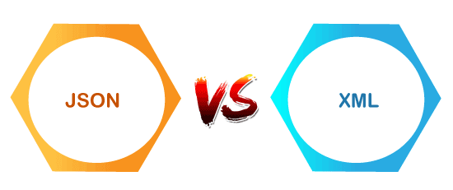
JSON | XML
JSON stands for javascript object notation. | XML stands for an extensible markup language.
The extension of json file is .json. | The extension of xml file is .xml.
The internet media type is application/json. | The internet media type is application/xml or text/xml.
The type of format in JSON is data interchange. | The type of format in XML is a markup language.

Slide 7
Prerequisite of semantic web
HTML:
Hypertext Markup Language
Basic building block of websites, giving structure to web pages
CSS:
Cascading Style Sheets
used to style and arrange the layout of web pages.
works with HTML to make sure the content looks good and is easy to use,
without changing the meaning of the content itself.
improves the design while keeping the structure clear and accessible.

Slide 8
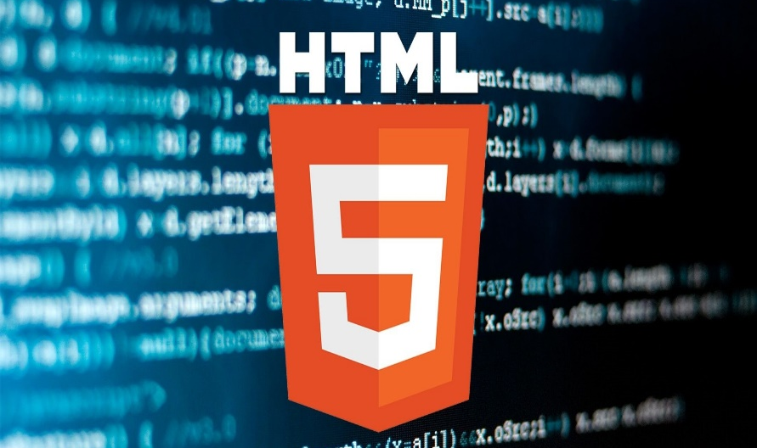
Html: structure and content
Semantic Markup Utilize HTML tags to convey the meaning and structure of web content, ensuring accessibility and search engine optimization. | Text Formatting Implement headings, paragraphs, lists, and other text-based elements to organize and present information effectively.

Slide 9
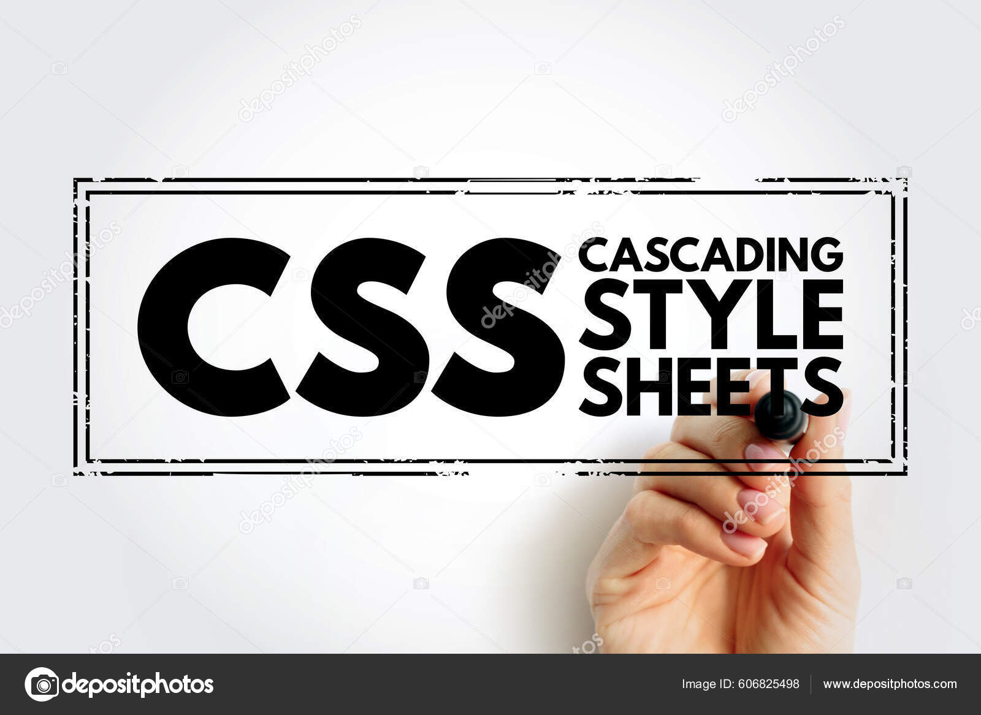
Css: styling and presentation
Selectors
Target specific HTML elements and apply styles using CSS selectors, from basic type-based to more advanced attribute-based selectors.
Properties
Utilize a wide range of CSS properties to control the appearance of web elements, including color, typography, layout, and more.
Responsive Design
Leverage CSS media queries to create adaptive layouts that provide an optimal viewing and interaction experience across different devices and screen sizes.

Slide 10
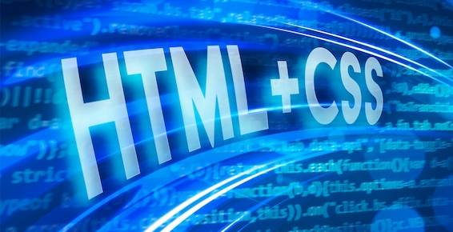
Combining HTML and CSS for Responsive Web Design
Structure
Establish a well-organized HTML structure that supports the desired layout and functionality.
Styling
Apply CSS to control the visual presentation and ensure consistency across the website.
Responsiveness
Implement media queries and flexible design patterns to adapt the website to different screen sizes and devices.

Slide 11
Rdf (resource description framework)
What is RDF? RDF is a standard model for data interchange on the Web. It represents information as subject-predicate-object triples. | RDF Serializations RDF data can be serialized in various formats like Turtle, RDF/XML, and JSON-LD. | RDF Advantages RDF allows data to be linked, discovered, and combined, enabling the Semantic Web vision.

Slide 12
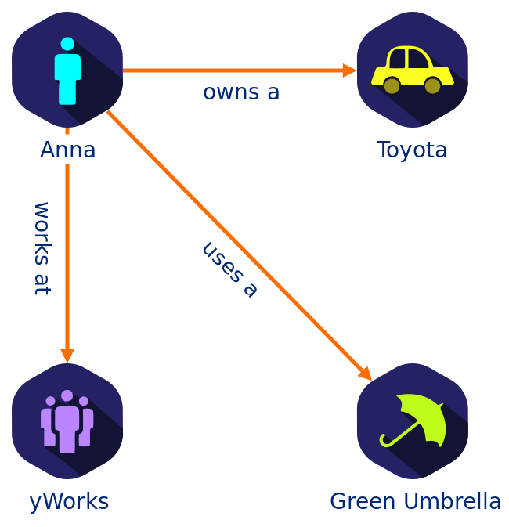
Ontologies and Vocabularies
Ontologies Ontologies define the concepts, relationships, and rules within a specific domain of knowledge.
Vocabularies Semantic vocabularies provide standardized terms and definitions for describing data on the Semantic Web.
Semantic Reasoning Ontologies enable advanced reasoning and inference capabilities for intelligent Semantic Web applications.

Slide 13

Owl ontology
Web Ontology language OWL is a language for defining ontologies on the Web.
An OWL Ontology describes a domain in terms of classes, properties and individuals and may include rich descriptions of the characteristics of those objects.
OWL ontologies can be used to describe the properties of Web resources .

Slide 14
SPARQL Query Language
1
2
3
Query RDF Data SPARQL is the standard query language for retrieving and manipulating data in RDF format. | Federated Queries SPARQL supports querying across multiple RDF data sources, enabling integrated access to linked data. | Powerful Capabilities SPARQL provides advanced features like pattern matching, aggregation, and inference for complex queries.

Slide 15
Linked data principles
Identifiable
Use URIs to identify things so they can be referenced and linked.
Structured
Represent data using the RDF data model for machine-readable meaning.
Linked
Create links between related data to enable discovery and integration.
Open
Make data openly available for anyone to use and reuse.

Slide 16
Applications of semantic web
Search engines
E-commerce
Healthcare
Education
Social media
Content Management
Autofill

Slide 17
Challenges and limitations
Adoption Challenges
Widespread adoption of semantic web standards and technologies remains a significant challenge.
Data Quality
Ensuring the accuracy, completeness, and reliability of semantic data is an ongoing concern.
Privacy and Security
Balancing the open, linked nature of the Semantic Web with privacy and security is crucial.

Slide 18
Future of semantic web
Continued Evolution Ongoing research and development will refine and expand the capabilities of the Semantic Web. | Emerging Applications New domains like the Internet of Things and AI will drive innovative Semantic Web use cases. | Societal Impact Enhanced data interoperability, Improved User experience, Automation and intelligent agents

Slide 19


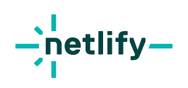

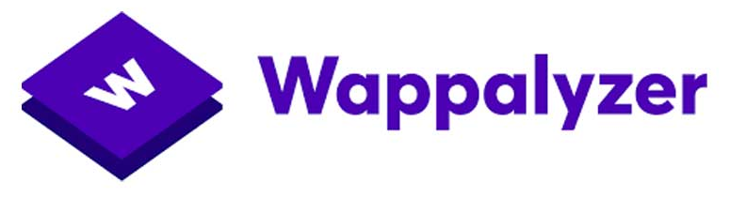

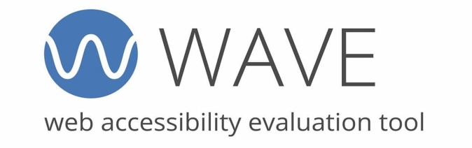
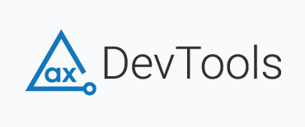
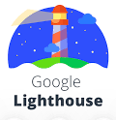
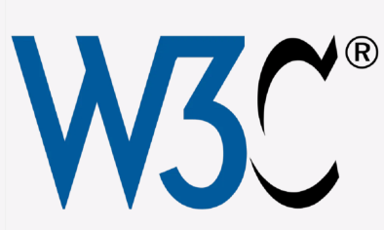
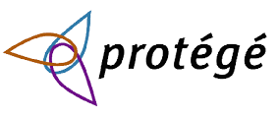
Software tools utilised

Slide 20
Thank you

